Slide 1
Provincial Research Advisory Committee (PRAC)
Manufacturing Cluster
28/06/2019

Slide 2
Overview
Overview
Objectives of the cluster
Focus areas
Composition
Reporting structure
Working process

Slide 3
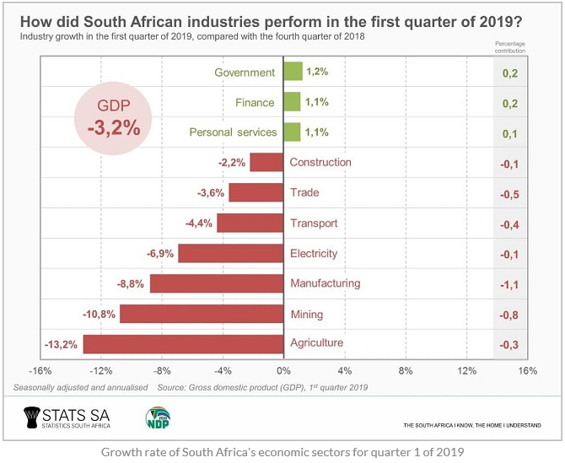
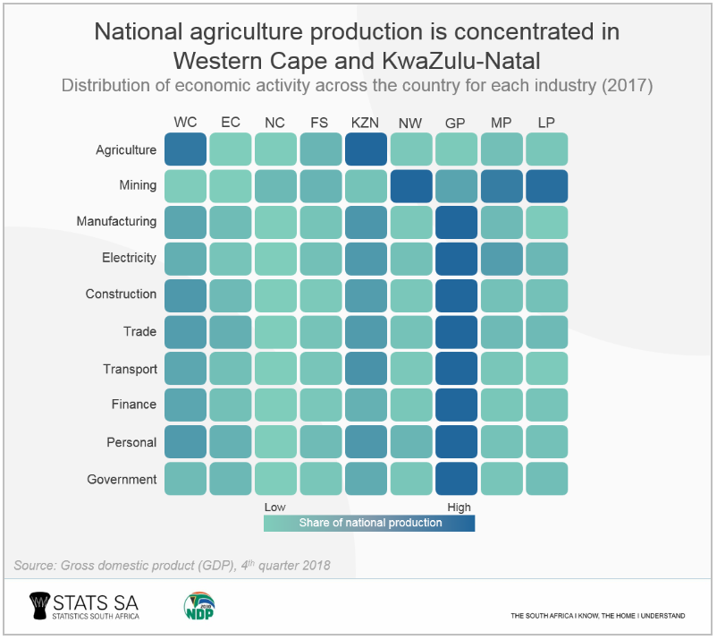
Overview

Slide 4
Overview
A look at the trends in unemployment by province over the last 10 years shows that two provinces, the Free State and the Eastern Cape, have consistently had the highest unemployment rates.

Slide 5
Objectives of the Cluster
Research
To identify blockages within the sector,
Coordination
Collective planning and implementation of programmes/projects;
Cooperation
Facilitate information sharing amongst all stakeholders.
New sub-sectors and high impact projects,
Identify opportunities within identified value chains in the manufacturing sector.
To facilitate ‘know the Free State programmes’ - Database of manufacturing enterprises – collective bargaining
Support programmes to facilitate entrepreneurship and create sustainable SMMEs,

Slide 6
Focus Areas
Skills Development
Formal trainings
Localisation
Localise products
Markets
Facilitate export markets
Capacity building workshops
Build local economy
Promote consumption of local goods

Slide 7
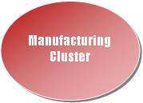
Composition
Industry Associations and Private Sector
Entities and Institutions of Higher Learning
Government (National, Provincial and Local)

Slide 8
Reporting Structure
Economic Cluster
Working stream 1
Working stream 3
HOD DESEA
Working stream 2
Cluster & PRAC

Slide 9
Working Process
PRAC
Manufacturing Cluster
Policy Implementation

Slide 10
Mpolokeng Mokalobe mokalobem@destea.go.za 051 400 9588 0827340102

Slide 11
Thank you

